Slide 1
Query Processing and Optimization

Slide 2
Query processing refers to the range of activities involved in extracting data from a database.
The activities include translation of queries in high-level database languages into expressions that can be used at the physical level of the file system, a variety of query-optimizing transformations, and actual evaluation of queries.
The steps involved in processing a query are:
1. Parsing and translation.
2. Optimization.
3. Evaluation.

Slide 3
Before query processing can begin, the system must translate the query into a usable form.
A more useful internal representation is one based on the extended relational algebra.
Thus, the first action the system must take in query processing is to translate a given query into its internal form.
This translation process is similar to the work performed by the parser of a compiler.

Slide 4
In generating the internal form of the query, the parser checks the syntax of the user’s query, verifies that the relation names appearing in the query are names of the relations in the database, and so on.
The system constructs a parse-tree representation of the query, which it then translates into a relational-algebra expression.
If the query was expressed in terms of a view, the translation phase also replaces all uses of the view by the relational-algebra expression that defines the view.

Slide 5
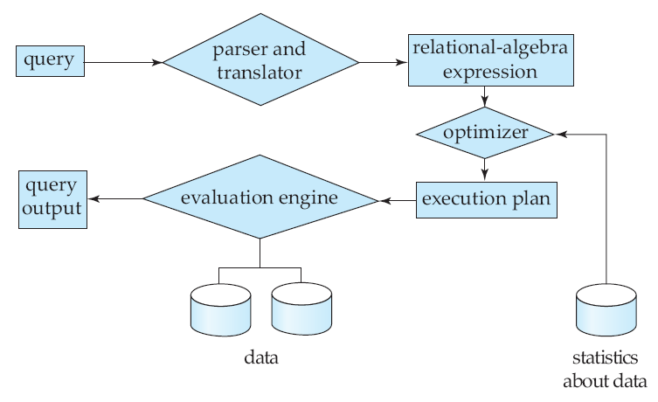
Steps in query processing

Slide 6
Given a query, there are generally a variety of methods for computing the answer.
Each SQL query can itself be translated into a relational algebra expression in one of several ways.
Furthermore, the relational-algebra representation of a query specifies only partially how to evaluate a query; there are usually several ways to evaluate relational-algebra expressions.
consider the query:
select salary
from instructor
where salary < 75000;

Slide 7
This query can be translated into either of the following relational-algebra expressions:
σsalary <75000 (πsalary (instructor))
π salary (σ salary<75000 (instructor))
Further, we can execute each relational-algebra operation by one of several different algorithms.
For example, to implement this, we can search every tuple in instructor to find tuples with salary less than 75000.

Slide 8
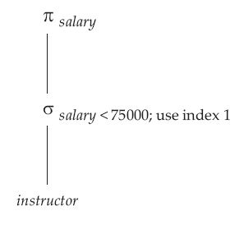
Query evaluation plan

Slide 9
A relational algebra operation interpreted with instructions on how to evaluate it is called an evaluation primitive.
A sequence of primitive operations that can be used to evaluate a query is a query-execution plan or query-evaluation plan.
In previous figure the evaluation plan for given query, in which a particular index (denoted in the figure as “index 1”) is specified for the selection operation.
The query-execution engine takes a query-evaluation plan, executes that plan, and returns the answers to the query.
The different evaluation plans for a given query can have different costs.

Slide 10
We do not expect users to write their queries in a way that suggests the most efficient evaluation plan.
Rather, it is the responsibility of the system to construct a query evaluation plan that minimizes the cost of query evaluation; this task is called query optimization.
Once the query plan is chosen, the query is evaluated with that plan, and the result of the query is output.

Slide 11
Query optimization
Query optimization is the process of selecting the most efficient query-evaluation plan from among the many strategies usually possible for processing a given query, especially if the query is complex.
We do not expect users to write their queries so that they can be processed efficiently. Rather, we expect the system to construct a query-evaluation plan that minimizes the cost of query evaluation.
One aspect of optimization occurs at the relational-algebra level, where the system attempts to find an expression that is equivalent to the given expression, but more efficient to execute.

Slide 12
Other aspect is selecting a detailed strategy for processing the query, such as choosing the algorithm to use for executing an operation, choosing the specific indices to use, and so on.
The difference in cost (in terms of evaluation time) between a good strategy and a bad strategy is often large, and may be several orders of magnitude.
Hence, it is worthwhile for the system to spend a substantial amount of time on the selection of a good strategy for processing a query, even if the query is executed only once.

Slide 13
Consider the following relational-algebra expression, for the query,
“Find the names of all instructors in the Music department together with the course title of all the courses that the instructors teach.”

Slide 14
πname,title(σdept-name=“Music”(instructor ( teaches πcourse_id,title(course))))

Slide 15
The projection of course on (name,title) is required since course shares an attribute dept name with instructor.
( if we did not remove this attribute using the projection, the above expression using natural joins would return only courses from the Music department, even if some Music department instructors taught courses in other departments.)
The above expression constructs a large intermediate relation,
instructor teaches πcourse id ,title (course).

Slide 16
However, we are interested in only a few tuples of this relation (those pertaining to instructors in the Music department), and in only two of the ten attributes of this relation.
Since we are concerned with only those tuples in the instructor relation that pertain to the Music department, we do not need to consider those tuples that do not have dept name = “Music”.

Slide 17
By reducing the number of tuples of the instructor relation that we need to access, we reduce the size of the intermediate result.
This query is now represented by the relational-algebra expression:
πname,title ((σdept name =“Music” (instructor)) (teaches
πcourse id ,title (course))).
which is equivalent to our original algebra expression, but which generates smaller intermediate relations.

Slide 18
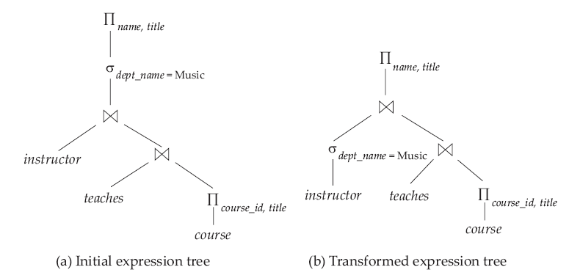
Equivalent expressions
Notes:
18

Slide 19
Consider the relational-algebra expression for the query
“Find the names of all customers who have an account at
any branch located in Brooklyn.”

Slide 20
This expression constructs a large intermediate relation, branch
account depositor.
However, we are interested in only a few tuples of this relation
(those pertaining to branches located in Brooklyn), and in
only one of the six attributes of this relation.
Since we are concerned with only those tuples in the branch relation
that pertain to branches located in Brooklyn, we do not need to
consider those tuples that do not have branch-city = “Brooklyn”.
By reducing the number of tuples of the branch relation that we need
to access, we reduce the size of the intermediate result.
This query is now represented by the relational-algebra expression,

Slide 21
which is equivalent to our original algebra expression,
but which generates smaller intermediate relations.
Following figure shows the initial and transformed expressions.

Slide 22
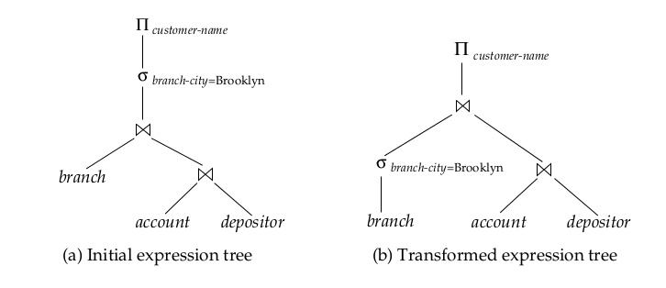

Slide 23
Heuristic Optimization
Cost-based optimization is expensive, even with dynamic programming.
Systems may use heuristics to reduce the number of choices that must be made in a cost-based fashion.
Heuristic optimization transforms the query-tree by using a set of rules that typically (but not in all cases) improve execution performance:
Perform selection early (reduces the number of tuples)
Perform projection early (reduces the number of attributes)
Perform most restrictive selection and join operations before other similar operations.
Some systems use only heuristics, others combine heuristics with partial cost-based optimization.

Slide 24
Performance Tuning in SQL

Slide 25
Tuning the performance of a system involves adjusting
various parameters and design choices to improve
its performance for a specific application.
Various aspects of a database-system design—
ranging from high-level aspects such as the schema and
transaction design to database parameters such as buffer sizes,
down to hardware issues such as number of disks—affect
the performance of an application.
Each of these aspects can be adjusted so that performance
is improved.

Slide 26
Database Tuning Options
Hardware Solution
Faster or additional Processors
Faster Disk IO (possibly via RAID)
More Network Bandwidth
More Memory
Software Solution
Database/Instance Tuning(Location of files, block size,
db buffer cache size, etc)
Object Tuning (Index creation, table reorganization, etc)
SQL Tuning (application tuning)

Slide 27
(A)Location of Bottlenecks
The performance of most systems (at least before they are tuned)
is usually limited primarily by the performance of one or a few
components, called bottlenecks.
For instance, a program may spend 80 percent of its time in a
small loop deep in the code, and the remaining 20 percent of the
time on the rest of the code; the small loop then is a bottleneck.
Improving the performance of a component that is not a bottleneck
does little to improve the overall speed of the system; in the
example, improving the speed of the rest of the code cannot
lead to more than a 20 percent improvement overall,
whereas improving the speed of the bottleneck
loop could result in an improvement of nearly 80 percent
overall, in the best case.

Slide 28
Hence, when tuning a system, we must first try to discover what the
bottlenecks are and then eliminate them by improving the
performance of system components causing the bottlenecks.
When one bottleneck is removed, it may turn out that another
component becomes the bottleneck.
In a well-balanced system, no single component is the bottleneck.
If the system contains bottlenecks, components that are not part of
the bottleneck are under utilized ,and could perhaps have been
replaced by cheaper components with lower performance.
For simple programs, the time spent in each region of the
code determines the overall execution time.

Slide 29
However, database systems are much more complex, and can
be modeled as queueing systems.
A transaction requests various services from the database
system, starting from entry into a server process, disk reads
during execution, CPU cycles, and locks for concurrency control.
Each of these services has a queue associated with it, and
small transactions may spend most of their time waiting in
queues—especially in disk I/O queues—instead of executing code.

Slide 30
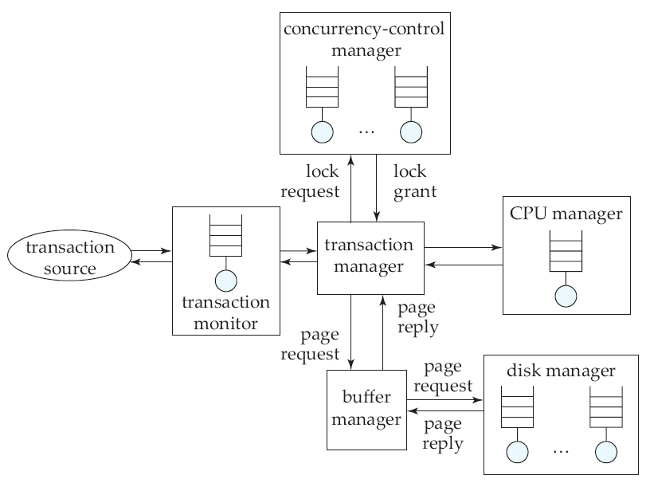

Slide 31
Figure illustrates some of the queues in a database system.
As a result of the numerous queues in the database, bottlenecks
in a database system
typically show up in the form of long queues for a particular service.
If requests are spaced exactly uniformly, and the time to service
a request is less than
or equal to the time before the next request arrives, then each
request will find the
resource idle and can therefore start execution immediately without
waiting.
Unfortunately, the arrival of requests in a database system is never
so uniform and is
instead random.

Slide 32
(B)Tunable Parameters
Database administrators can tune a database system at three levels.
The lowest level is at the hardware level.
Options for tuning systems at this level include adding disks or using
a RAID system if disk I/O is a bottleneck, adding more memory if the
disk buffer size is a bottleneck, or moving to a faster processor if
CPU use is a bottleneck.
The second level consists of the database-system parameters,
such as buffer size and checkpointing intervals.
The exact set of database-system parameters that can be tuned
depends on the specific database system.

Slide 33
Most database-system manuals provide information on what
database-system parameters can be adjusted, and how you should
choose values for the parameters.
Well-designed database systems perform as much tuning as possible
automatically, freeing the user or database administrator from the
burden. For instance, in many database systems the buffer size is
fixed but tunable.
If the system automatically adjusts the buffer size by observing
indicators such as page-fault rates, then the database administrator
will not have to worry about tuning the buffer size.
-Page fault rate is raised by computer hardware when a
running program accesses a memory page that is mapped into
the virtual address space, but not actually loaded into main memory.

Slide 34
The third level is the highest level. It includes the schema
and transactions.
The administrator can tune the design of the schema, the indices
that are created, and the transactions that are executed, to
improve performance.
Tuning at this level is comparatively system independent.
The three levels of tuning interact with one another; we must
consider them together when tuning a system.
For example, tuning at a higher level may result in the hardware
bottleneck changing from the disk system to the CPU, or vice versa.

Slide 35
(C)Tuning of the Schema
Within the constraints of the chosen normal form, it is possible to
partition relations vertically.
For example, consider the course relation, with the schema:
course (course id, title, dept name, credits)
for which course id is a key.
Within the constraints of the normal forms
(BCNF and third normal forms), we can partition the course
relation into two relations:
course credit (course id, credits)
course title dept (course id, title, dept name)
The two representations are logically equivalent,
since course id is a key, but they have different performance
characteristics.

Slide 36
If most accesses to course information look at only the course id
and credits, then they can be run against the course credit relation,
and access is likely to be somewhat faster, since the title and dept
name attributes are not fetched.
For the same reason, more tuples of course credit will fit in the
buffer than corresponding tuples of course, again leading to faster
performance.
This effect would be particularly marked if the title and dept name
attributes were large.
Hence, a schema consisting of course credit and course title dept
would be preferable to a schema consisting of the course relation
in this case.
On the other hand, if most accesses to course information require
both dept name and credits, using the course relation would be
preferable, since the cost of the join of course credit and course
title dept would be avoided.

Slide 37
(D)Tuning of Indices
We can tune the indices in a database system to improve performance.
If queries are the bottleneck, we can often speed them up
by creating appropriate indices on relations.
If updates are the bottleneck, there may be too many indices,
which have to be updated when the relations are updated.
Removing indices may speed up certain updates.
The choice of the type of index is also important.
Some database systems support different kinds of indices,
such as hash indices and B-tree indices.

Slide 38
If range queries are common, B-tree indices are preferable to
hash indices.
Whether to make an index a clustered index is another tunable
parameter.
Only one index on a relation can be made clustered, by storing
the relation sorted on the index attributes.
Generally, the index that benefits the greatest number of queries
and updates should be made clustered.

Slide 39
(E)Performance Simulation
To test the performance of a database system even before it is
installed, we can create a performance-simulation model of the
database system.
Each service such as the CPU, disk, the buffer, and the concurrency
control, is modeled in the simulation.
Instead of modeling details of a service, the simulation model may
capture only some aspects of each service, such as the
service time—that is, the time taken to finish processing a
request once processing has begun.
Thus, the simulation can model a disk access from just the average
disk-access time.
Since requests for a service generally have to wait their turn, each
service has an associated queue in the simulation model.

Slide 40
A transaction consists of a series of requests. The requests
are queued up as they arrive, and are serviced according to
the policy for that service, such as first come, first served.
The models for services such as CPU and the disks
conceptually operate in parallel, to account for the fact
that these subsystems operate in parallel in a real system.
Once the simulation model for transaction processing is
built, the system administrator can run a number of
experiments on it.

Slide 41
(F)Automated Tuning of Physical Design
Most commercial database systems today provide tools
to help the database administrator with index and materialized
view selection, and other tasks related to physical database
design such as how to partition data in a parallel database
system.
These tools examine the workload and suggest indices
and views to be materialized.
The database administrator may specify the importance of
speeding up different queries, which the tool takes into
account when selecting views to materialize.

Slide 42
Often tuning must be done before the application is
fully developed, and the actual database contents may be
small on the development database, but expected to be
much larger on a production database.
Thus, some tuning tools also allow the database
administrator to specify information about the expected
size of the database and related statistics.

Slide 43
(G) Tuning of Concurrent Transactions
Concurrent execution of different types of transactions can
sometimes lead to poor performance because of contention
on locks.
Long update transactions can cause performance problems
with system logs, and can increase the time taken to recover
from system crashes.
If a transaction performs many updates, the system log may
become full even before the transaction completes, in which
case the transaction will have to be rolled back.
To avoid such problems, many database systems impose
strict limits on the number of updates that a single transaction
can carry out.

Slide 44
References
https://www.youtube.com/watch?v=Sn_Wkf9KNEg
https://www.wisdomjobs.com/e-university/database-system-concepts-tutorial-528/
query-processing-15035.html
https://www.db-book.com › slide-dir
Sixth Edition Avi Silberschatz Henry F. Korth
S. Sudarshan
Book-Database System Concepts.

Slide 45
END

